Slide 1
What’s New in 2010
MSDN/Licensing Changes
+ Visual Studio 2010
Original author: Steve Lange
Modification by Cuong

Slide 2
Agenda
Introductions
What’s New in 2010?
Product Lineup
MSDN & Licensing Changes
What it Means to You
What’s New in Visual Studio 2010
Team Foundation Server
Architecture & Modeling
Development
Testing
Q&A
Close & Next Steps

Slide 3
What’s New In 2010?
Product Lineup & MSDN Changes

Slide 4
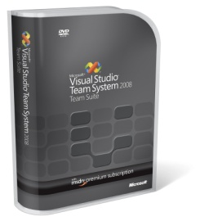
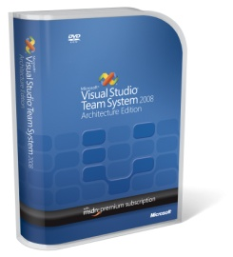

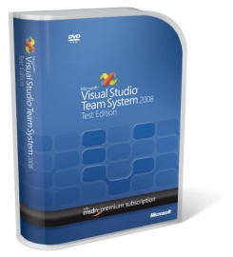
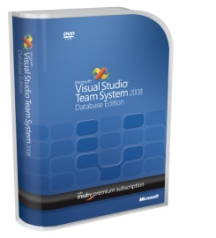
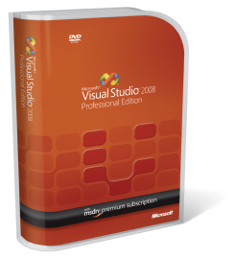
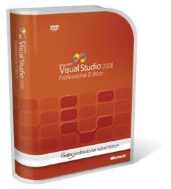
Visual Studio 2008
Visual Studio Team System 2008
Team Suite with MSDN Premium
Visual Studio Team System 2008
Team Editions with MSDN Premium
Visual Studio 2008 Professional
with MSDN Premium
Visual Studio 2008 Professional
with MSDN Professional

Slide 5




Visual Studio 2010

Slide 6


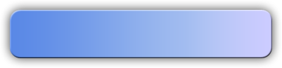


Test and Lab Manager
IntelliTrace™
Test Case Management
UML Modeling
Manual Testing
Architecture Explorer
Test Record & Playback
Logical Class Designer
Layer Diagram
Load Testing
Web Testing
UI Test Automation
Test Impact Analysis
Performance Profiling
Static Code Analysis
Code Coverage
Code Metrics
Database Change Mgmt
Database Deployment
Database Unit Testing
Test Data Generation
Silverlight Tools
Multi-core Development
SharePoint Development
Cloud Development
Web Development
Windows Development
Generate from Usage
Office Development
New WPF Editor
Customizable IDE

Slide 7
Visual Studio 2010 SKUs
Development & Test Environments
Visual Studio 2010 Ultimate with MSDN
Visual Studio IDE
Test and Lab Manager
Visual Studio 2010 Premium with MSDN
Visual Studio IDE
Visual Studio 2010 Professional with MSDN
Visual Studio IDE
Visual Studio Test Elements 2010 with MSDN
Test and Lab Manager
Server Products
Visual Studio Team Foundation Server 2010
Server/CAL licensing
Visual Studio Team Lab Management 2010
Server/per processor licensing
Requires Test Elements or Ultimate
Additional Products
Visual Studio Load Test Virtual User Pack 2010
1,000 virtual users

Slide 8
The New MSDN
Software for Production Use | Visual Studio 2010 Ultimate with MSDN | Visual Studio 2010 Premium with MSDN | Visual Studio 2010 Professional with MSDN | Visual Studio Test Elements 2010 with MSDN
Visual Studio® Team Foundation Server 2010 and one (1) Client Access License (New!) | ● | ● | ● | ●
Microsoft® Expression Studio 3 (New!) | ● | ● | ◌ | ◌
Microsoft® Office 2007 Ultimate, Communicator 2007, Project 2007 Standard, Visio 2007 Professional, SharePoint Designer 2007 | ● | ● | ◌ | ◌
See the Visual Studio 2010 Feature Matrix for a complete list of features.

Slide 9
The New MSDN (cont.)
Software for Development and Test Use | Visual Studio 2010 Ultimate with MSDN | Visual Studio 2010 Premium with MSDN | Visual Studio 2010 Professional with MSDN | Visual Studio Test Elements 2010 with MSDN
Windows® Azure™ (New!) | ● | ● | ● | ◌
Windows (client and server) | ● | ● | ● | ●
Microsoft® SQL Server® | ● | ● | ● | ●
Toolkits, Software Development Kits, Driver Development Kits | ● | ● | ● | ●
Microsoft® Office | ● | ● | ◌ | ◌
Microsoft Dynamics® | ● | ● | ◌ | ◌
All other servers | ● | ● | ◌ | ◌
Windows Embedded operating systems (New!) | ● | ● | ◌ | ◌
See the Visual Studio 2010 Feature Matrix for a complete list of features.

Slide 10
The New MSDN (cont.)
Subscription Benefits | Visual Studio 2010 Ultimate with MSDN | Visual Studio 2010 Premium with MSDN | Visual Studio 2010 Professional with MSDN | Visual Studio Test Elements 2010 with MSDN
Microsoft® E-Learning course collections (New!) | 2 | 2 | 1 | 1
Technical support incidents | 4 | 4 | 2 | 2
Priority support in MSDN Forums (New!) | ● | ● | ● | ●
MSDN Flash newsletter | ● | ● | ● | ●
MSDN Magazine | ● | ● | ● | ●
Online Concierge | ● | ● | ● | ●
See the Visual Studio 2010 Feature Matrix for a complete list of features.

Slide 11
Visual Studio 2010
What’s New

Slide 12
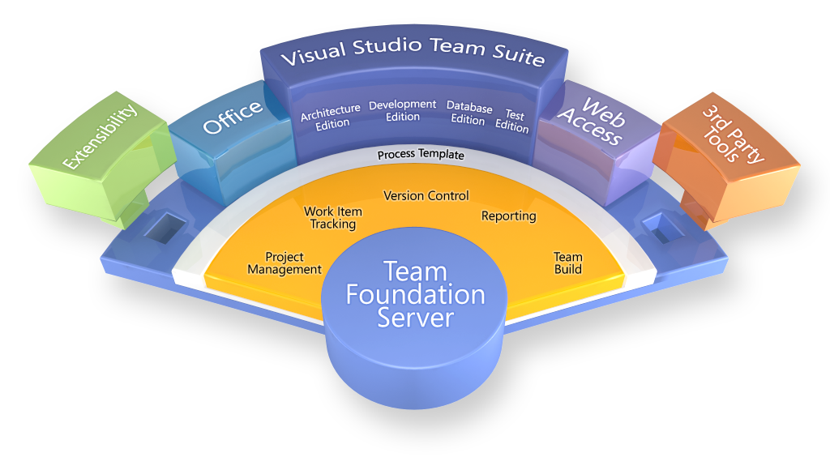
Visual Studio 2008 Lineup

Slide 13
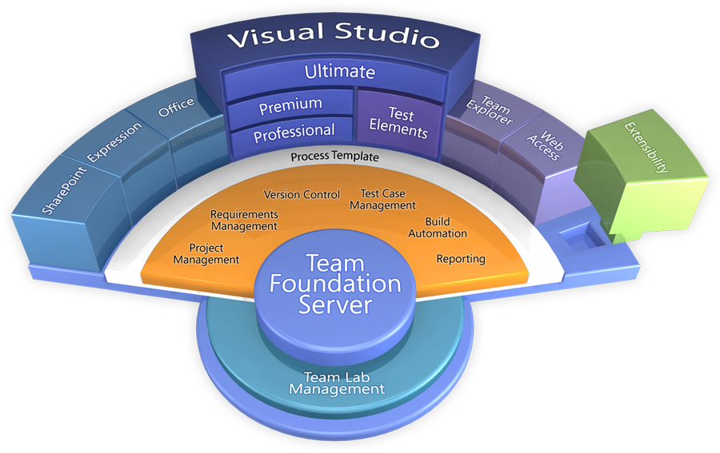
Visual Studio 2010 Lineup

Slide 14
Team Foundation Server
Visual Studio 2010

Slide 15










What is Team Foundation Server?
Team Foundation Server
A unified project server
Developer
Database Professional
Designer
Architect
Tester
Business Analyst
Project Manager

Slide 16
Team Foundation Server At a Glance
Process Focused
Process Templates
SharePoint
Customizable
Version Control
Integrated Check-in
Check-in Policies
Shelving
Work Item Tracking
Manage work
Bugs, Tasks, Requirements, Stories, Risks, etc.
Very Extensible
Build Automation
Continuous Integration
Scheduled
Ad Hoc
Reporting
Decision Support
Track Project Progress
Team Foundation Server

Slide 17
Team Foundation Server 2010
Manage Your Project
Report on Your Portfolio
Understand Parallel Development
Create a Supportive Build Workflow

Slide 18
TFS 2010: Manage Your Project
Agile project management workbooks
Work item linking and hierarchy
Work item usability
Rich text
Links control
HTML link control
Drag & Drop
Traceability queries
Query folders
Excel & Project improvements
Project round tripping
Formula persistence
Undo

Slide 19

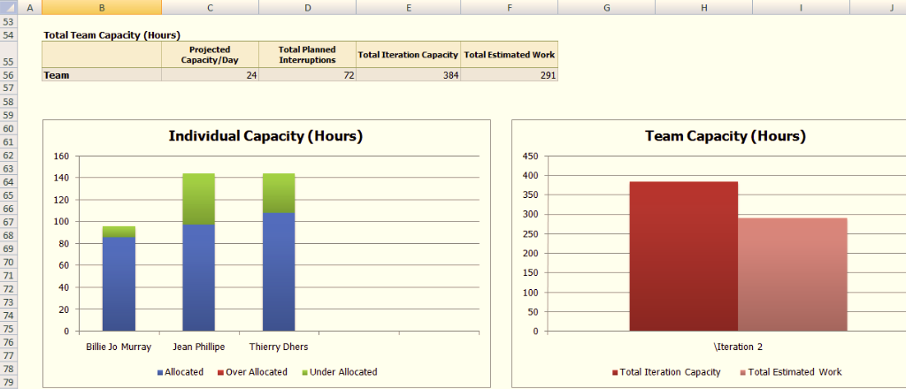
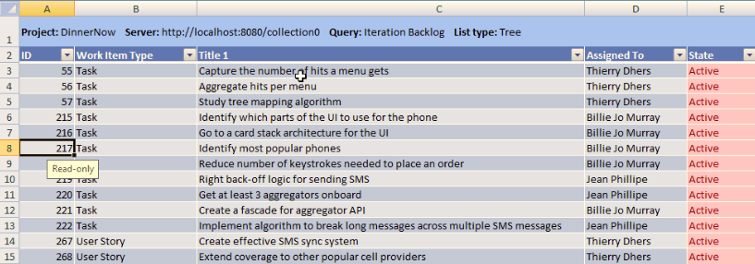
TFS: Manage Your Project
Top-to-Bottom Traceability
Requirements Traceability
Parent/Child Relationships
Rollup and Drilldown
Agile Planning
Built-in product backlog mgmt
Built-in iteration planning
Easily customizable
Greater Project Integration
Full dependency linking
Full round-tripping w/ TFS

Slide 20
demo
Manage Your Project

Slide 21
TFS 2010: Report on Your Entire Portfolio
Customizable Dashboards
Excel reports using MOSS
Relational warehouse
Excel reporting

Slide 22
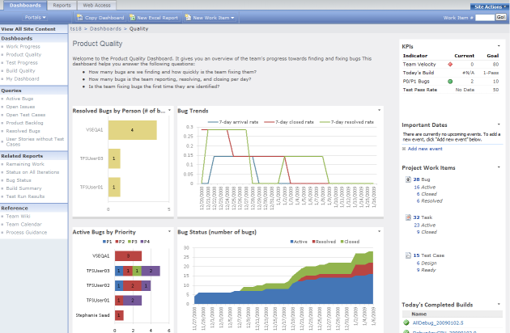
Dashboards
Information-rich dashboards
Roll-up reports show KPI’s
Drill-down for further analysis
Quickly customizable
Easy interaction with developers
Web-based bug filing
Web-based feature requests
Track status of bugs / features

Slide 23
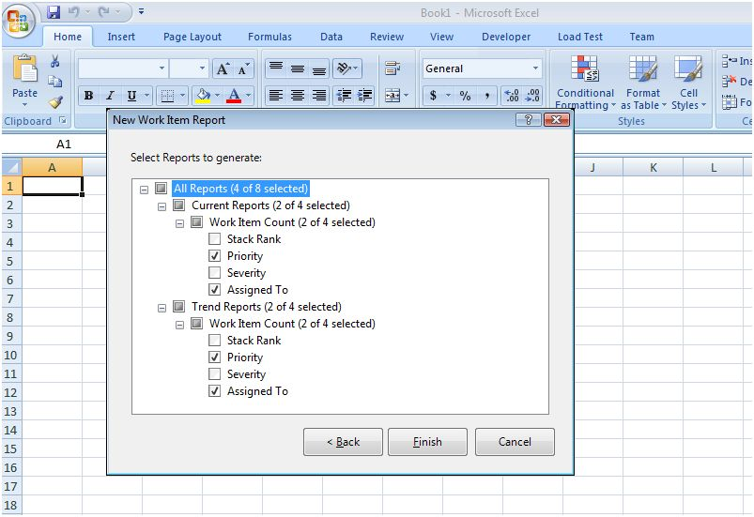
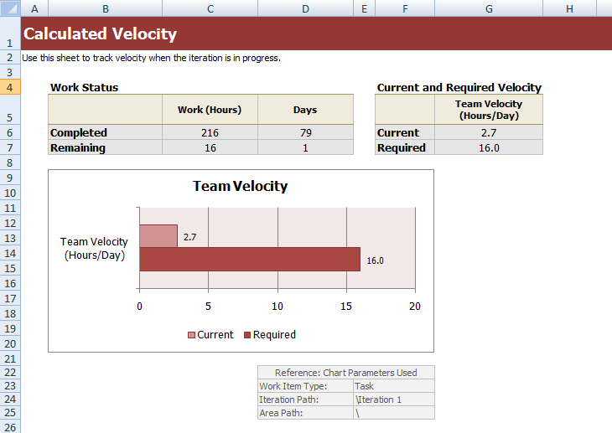
Report on Your Entire Portfolio
Customizable Dashboards
SharePoint web parts
TFSWA
Excel reports using MOSS
Relational warehouse
Excel reporting

Slide 24
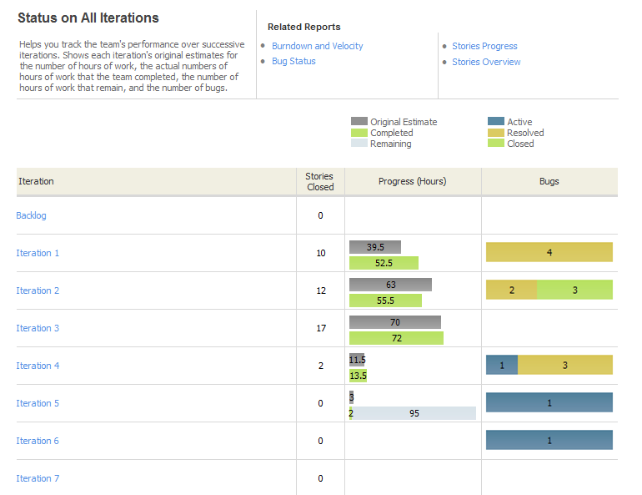
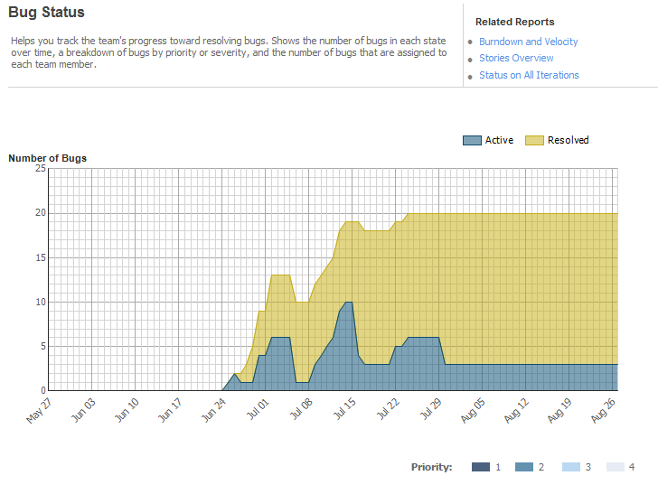
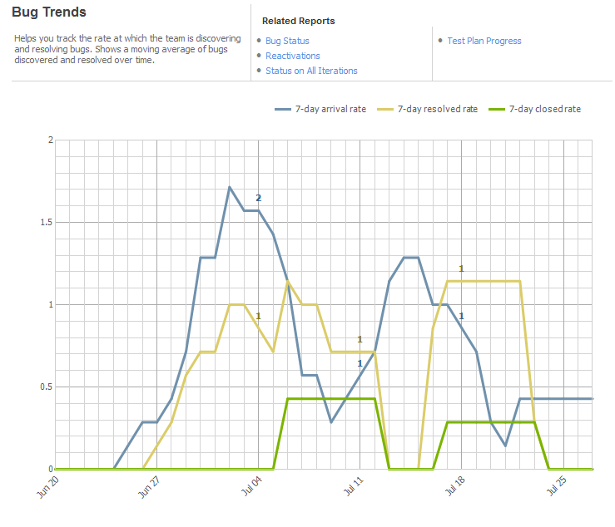
Reports

Slide 25
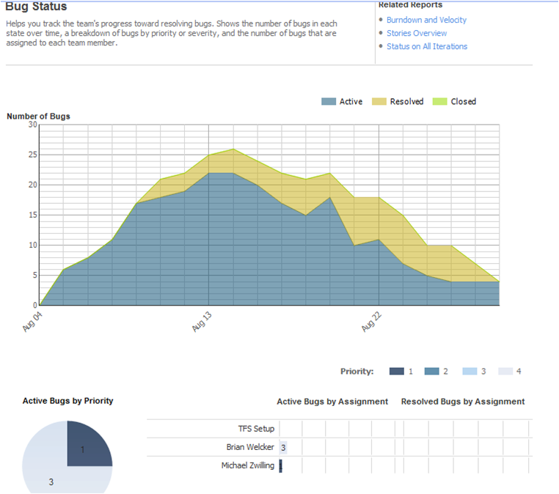
How many bugs do we have?
Shows bug state,priority, severity, and who they are assigned too
Shows state of bugs over time and by priority

Slide 26
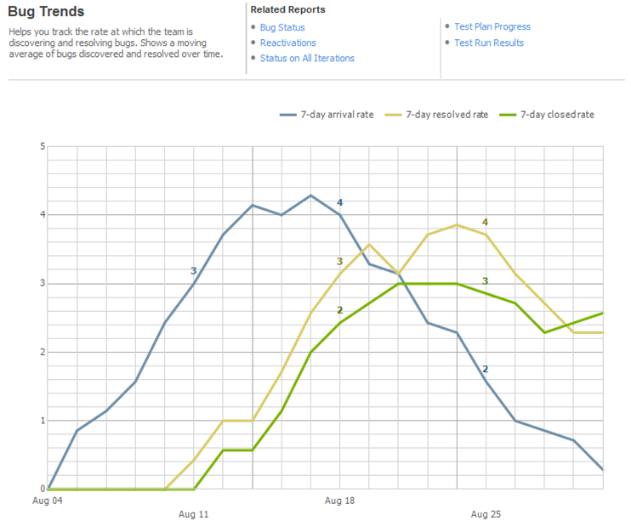
How fast are bugs being found and fixed?
Shows the rate of discovering and resolving bugs
Track the rate bugs are found and fixed

Slide 27
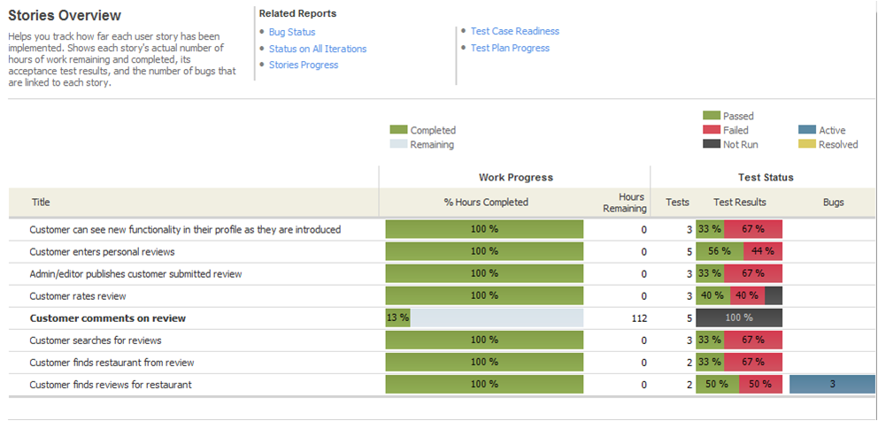
How are the user stories tracking?
Shows how far each user story has been implemented

Slide 28
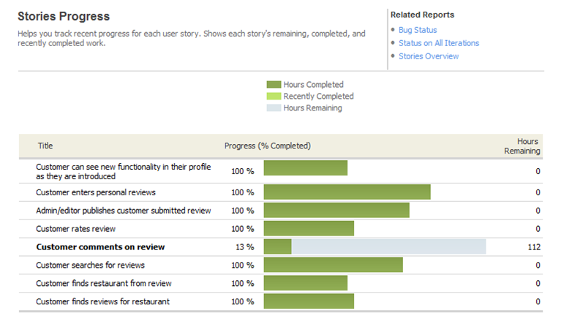
How many stories are remaining?
Shows hours of work remaining and completed per user story

Slide 29
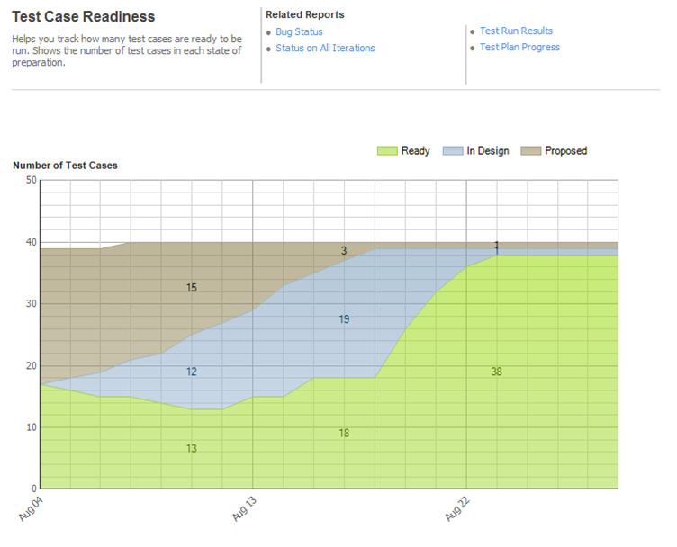
How many test cases are ready to run?
Shows what state the test cases are in

Slide 30
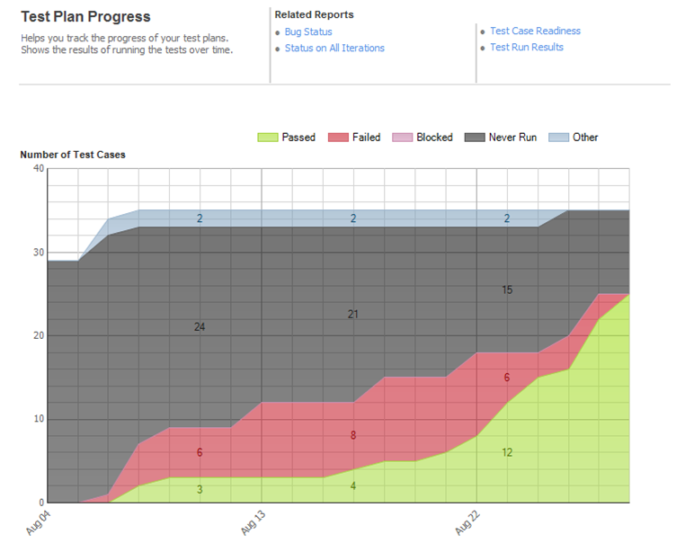
What is the progress or our test plans?
Shows the progress of your test plan

Slide 31
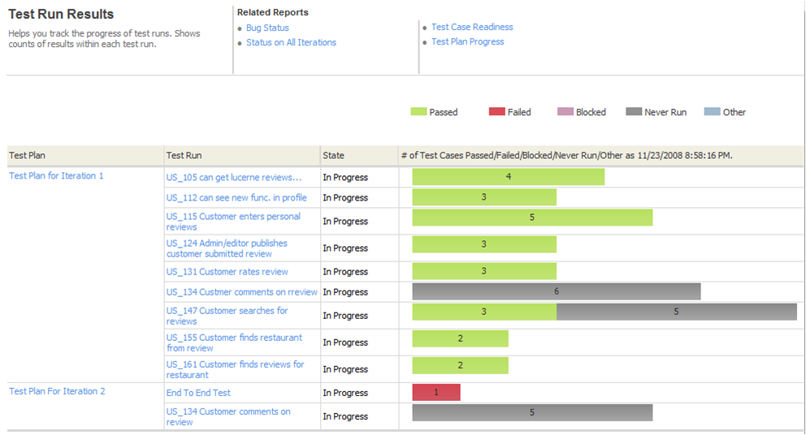
What is the progress or our test runs?
Shows the progress of your test runs

Slide 32
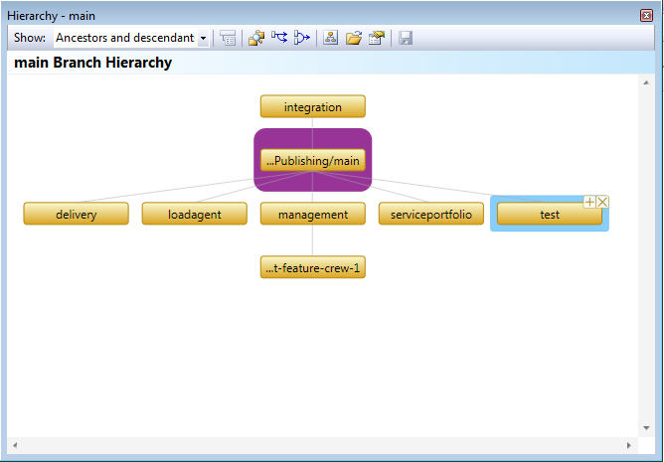
TFS 2010: Understand Parallel Development
First class branches
Drag & Drop Merging
Visualize branch relationships
Track change across branches
History
Timeline
Richer Annotate
Conflict resolution

Slide 33
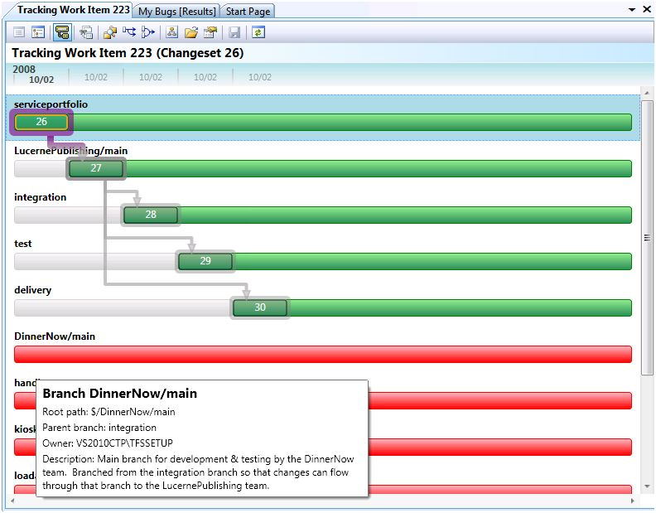
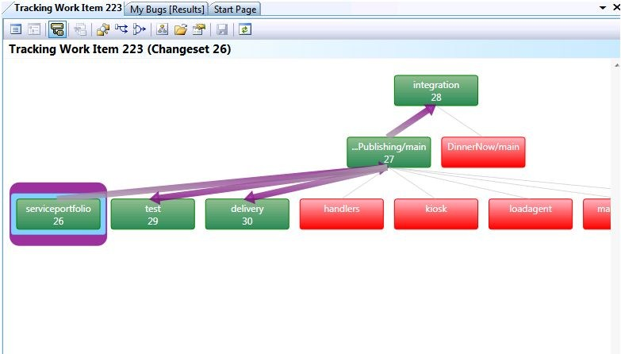
TFS 2010: Understand Parallel Development

Slide 34
TFS 2010: Create a Supportive Build Workflow
Gated check-in
Essential for large teams & few branches.
Layer Diagram Validation
Distributed build
Faster builds, faster iterations
Shelveset build
Integration validation without risking the build.
Build notifications
Tray app for instant notification
Build Details View with links to errors/warnings
Direct navigation to problem source
Ensure designed architecture is met

Slide 35
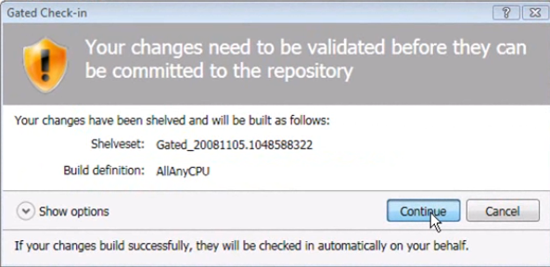
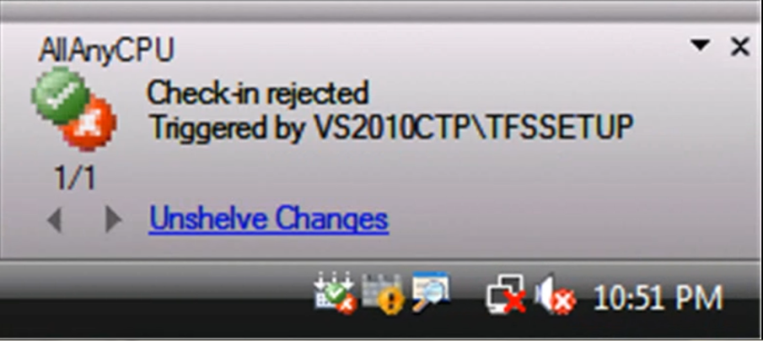
Gated Checkin

Slide 36
For Non-.NET Development
Teamprise (acquired by Microsoft)
Eclipse plug-in for TFS
Rich client (Java-based)
Command-Line
Runs on any Java-supported platform

Slide 37
Architecture & Modeling
Visual Studio 2010

Slide 38
Architecture & Modeling
Expanded Diagram Support
Layer
Architecture Explorer
UML Diagrams
Activity
Component
Class
Sequence
Use Case

Slide 39
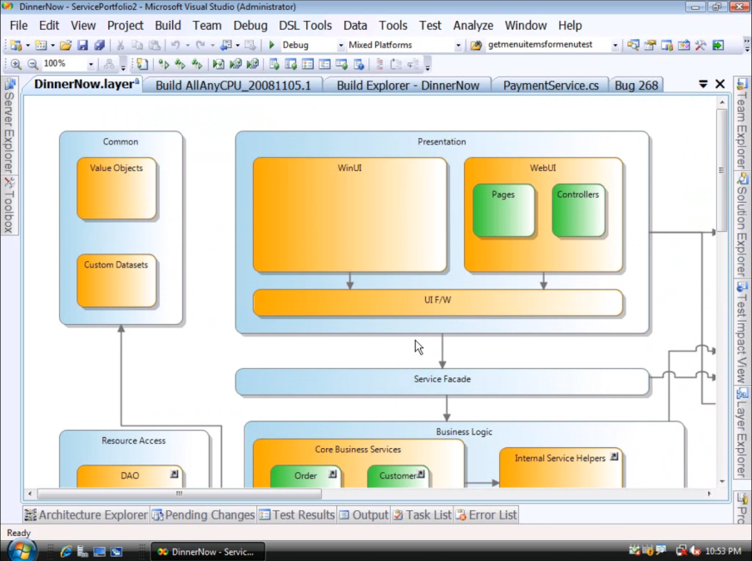
Layer Diagram
Architectural validation ensures code matches intended design.
Layer diagram details the intended design.
Classes and namespaces are mapped to layers in the diagram.

Slide 40
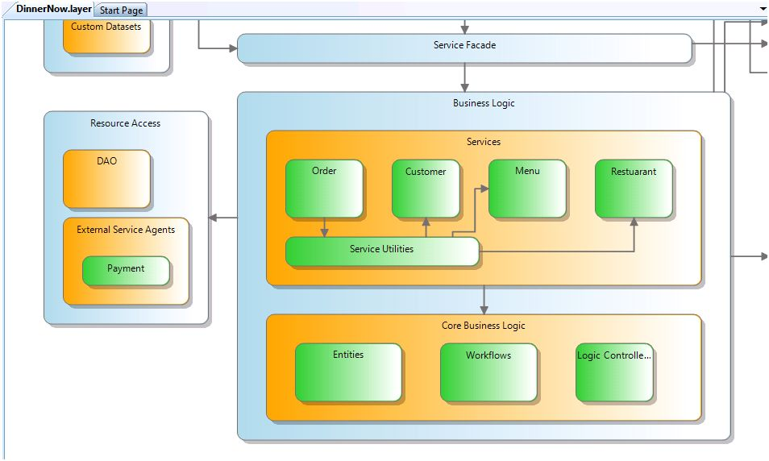

Slide 41
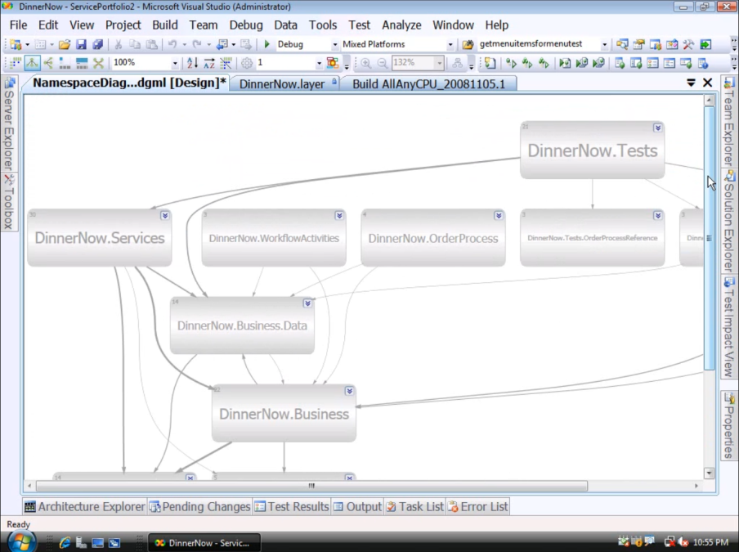
Architecture Explorer
Understanding a system can prevent the butterfly effect.
Architecture Explorer helps discover and understand how a system works.
Visualize existing code assets and how they connect.

Slide 42
demo
Architecture Explorer

Slide 43
Generating Sequence Diagrams

Slide 44
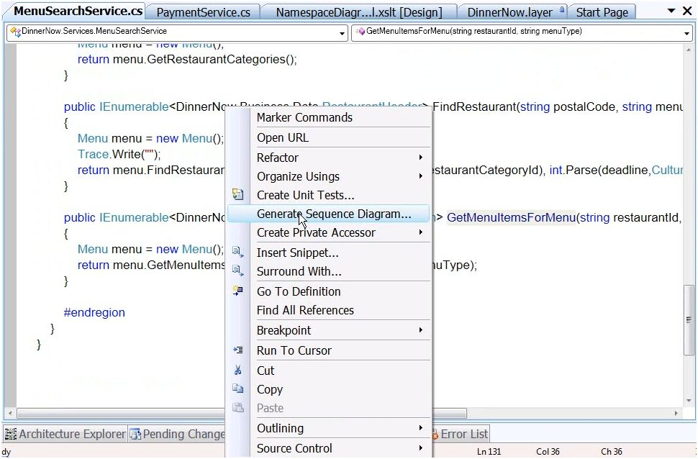

Slide 45
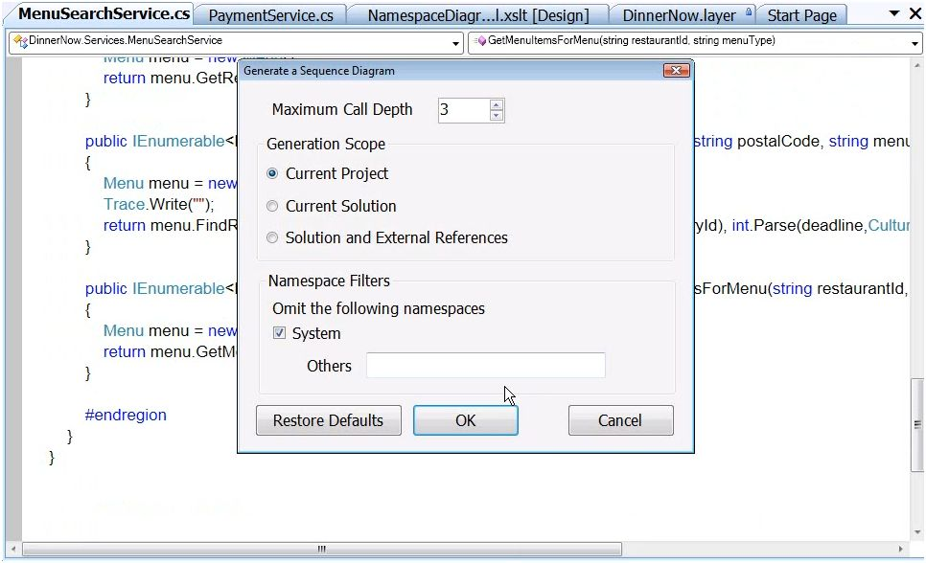

Slide 46
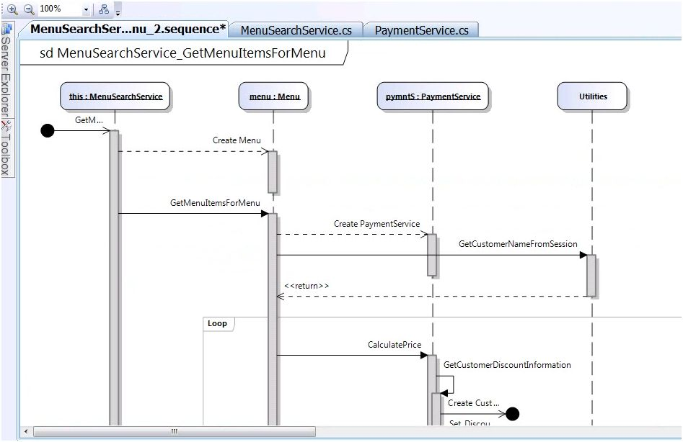

Slide 47
Development
Visual Studio 2010

Slide 48
Development
IntelliTrace
Test Impact Analysis
Improved Code Analysis
Improved Code Coverage
Improved Profiling

Slide 49
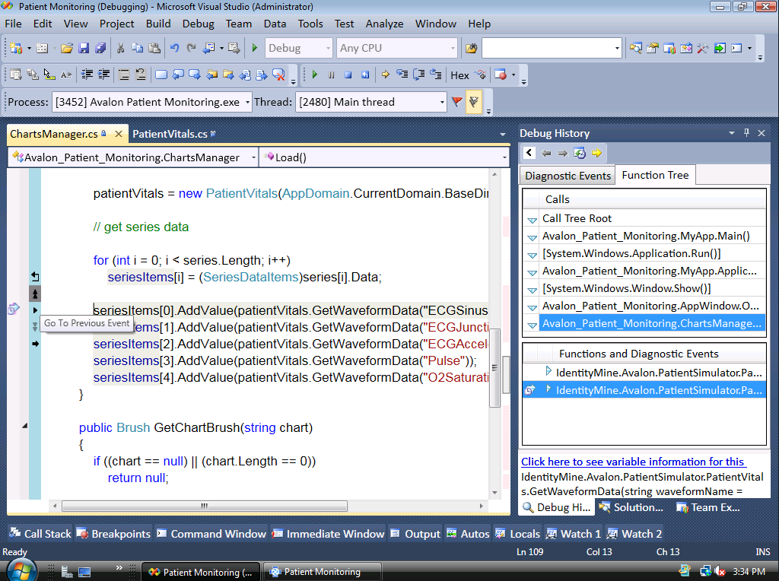
IntelliTrace
Application flight recorder and debugger
Reduce “no repro” bugs
Bridge gap between test and development
Dynamically instruments code
Records program execution flow
Records program data (parameters & return values)

Slide 50
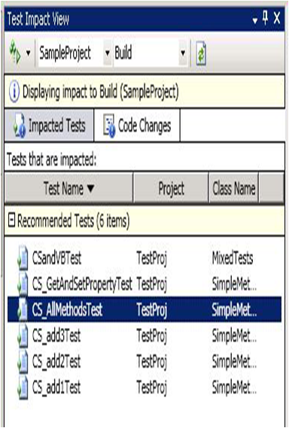
Test Impact Analysis
Identifies tests impacted by code changes
Reduces test time
Compares code changes with coverage data.
Recommends tests to run based on coverage impacted.
Enhance development process by requiring verification of impacted automated tests before developers check changes into Source Control System (TFS)

Slide 51
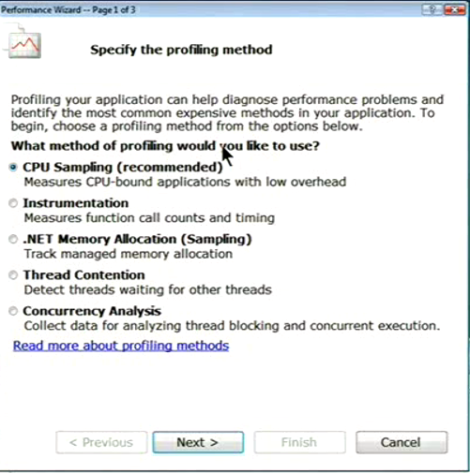
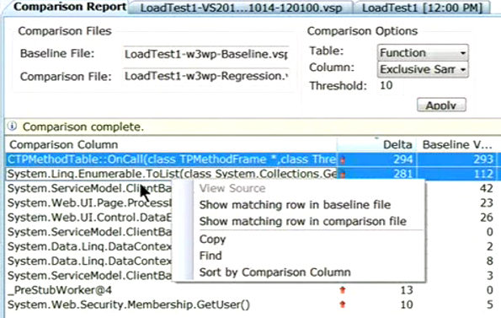
Profiler
Virtualization Support
Concurrency Profiling
Just My Code
Editor Integration
New Summary and Function Details reports
Rules and Guidance
Tier Interaction Profiling
Client Side JavaScript Profiling
Attach to Applications running on .NET 4.0

Slide 52
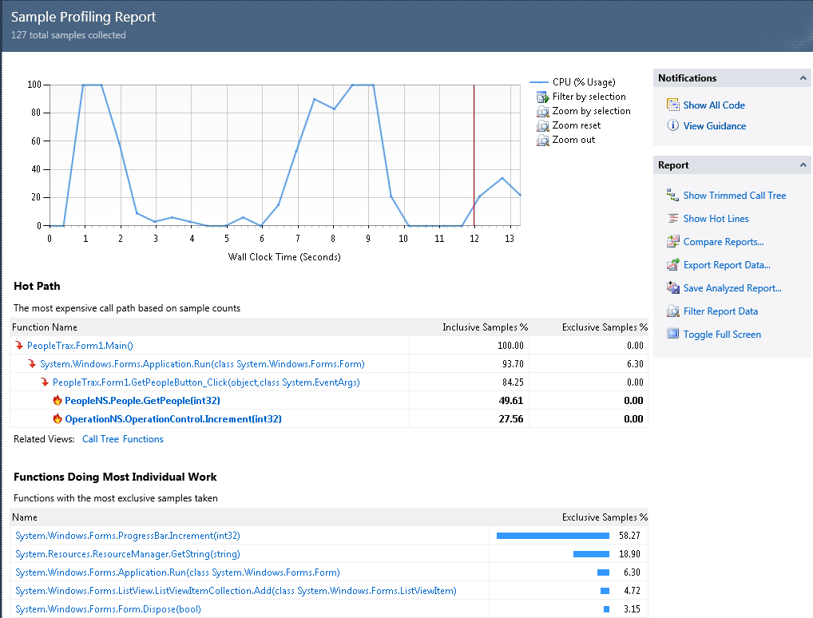
Profiler – Summary Report
Easily Locate Performance Spikes
Identify Most Expensive Call Path
Detect Functions responsible for most work

Slide 53
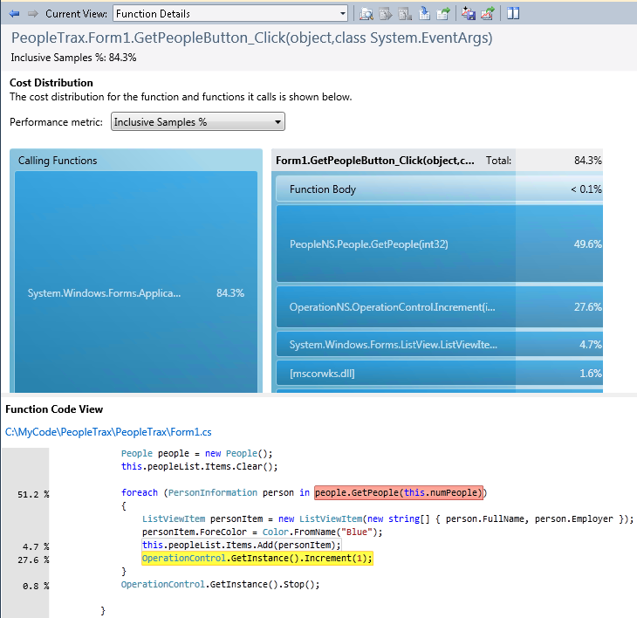
Profiler – Details Report
Visualize the call pattern of each method along with corresponding performance data
Identify code with considerable performance impact

Slide 54
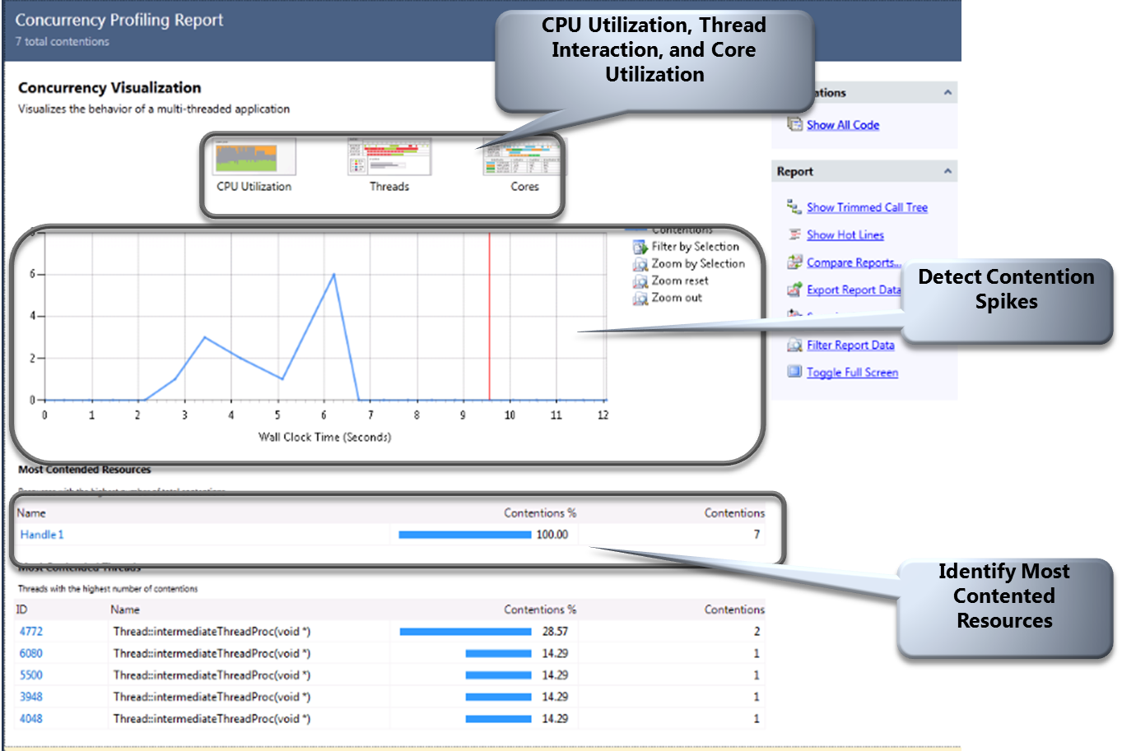
Profiler – Concurrency Profiling
Observe the behavior of a multi-threaded application
2 Concurrency Profiling Modes
Resource Contention – Light weight, low overhead view of multi-threaded application with a focus on synchronization and locks
Concurrency Visualizer – Comprehensive view of multi-threaded applications including how multiple cores are utilized

Slide 55
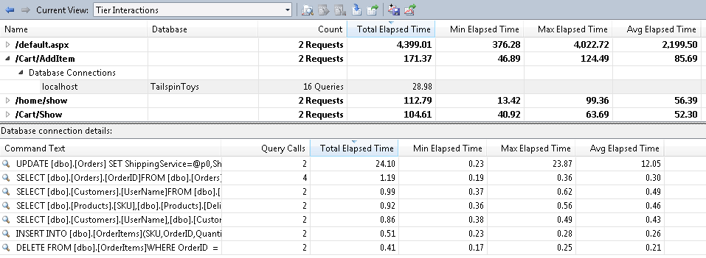
Profiler – Tier Interaction
Analyze the performance of a multi-tier application against its Data tier and SQL Server
Analyze page request patterns and database interactions for web applications

Slide 56
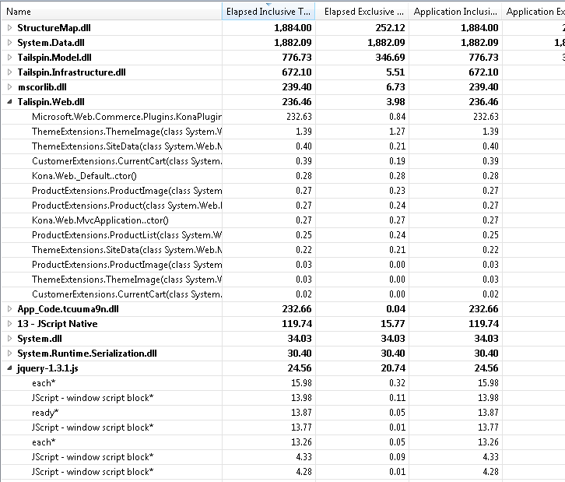
Profiler – Jscript Profiling
Application Performance
Ajax Performance

Slide 57
Database Development
Additional refactoring options
Rename object
Rename server or database references
Move database object between schemas
Fully qualify database object names
Expand wildcards in SELECT statements
Oracle support is in Beta (from Quest)

Slide 58
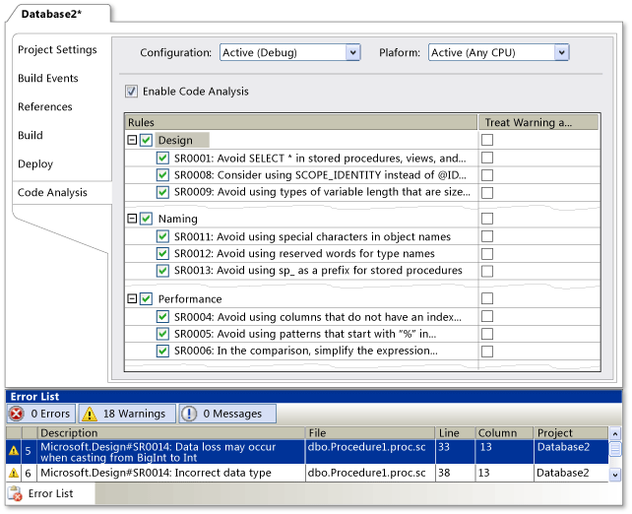
Database Development
Improved Database Code Analysis
T-SQL Design Issues
T-SQL Naming Issues
T-SQL Performance Issues

Slide 59
Testing
Visual Studio 2010

Slide 60

Tester Segmentation
generalist |  |  | specialist
manual testing | some scripting creates scripts to set up lab, create data | strong scripting skills some coding skills |  | strong coding develops fully automated testing procedures | expert coding skills
70% of testing happens here
majority of test tools target here
black box testing
white box testing
api testing

Slide 61
VS 2010 Test Capabilities
generalist
specialist
coded UI test
test runner
web performance test
unit testing
load test
test case management
virtual lab management
data diagnostic adapters (video, action log, event log etc)
team foundation server with reporting
(bugs, requirements, user stories, source control, build)

Slide 62
Key Test Capabilities in VS2010
Test Case Management
Test Plans, Test Suites, & Test Cases
Lab Management
Setup/Tear down
Rich & Actionable Bugs
Perform Exploratory testing
Coded UI Test
Virtualized test environments
Recordings, screenshots, system info
Reduce “ping pong” effect
“Wander” application, bug hunting
Control assertions
Code-level playback & validation

Slide 63
Test Case Management
Create, organize, and run test cases
Manage a suite hierarchy
Configure active iterations
First-class Work Items in TFS
Can be data-driven

Slide 64
Test Suites
Collection of related test cases
Flexible setup
Static
Query-based (dynamic)
Requirements-based

Slide 65
demo
Test Case Management

Slide 66
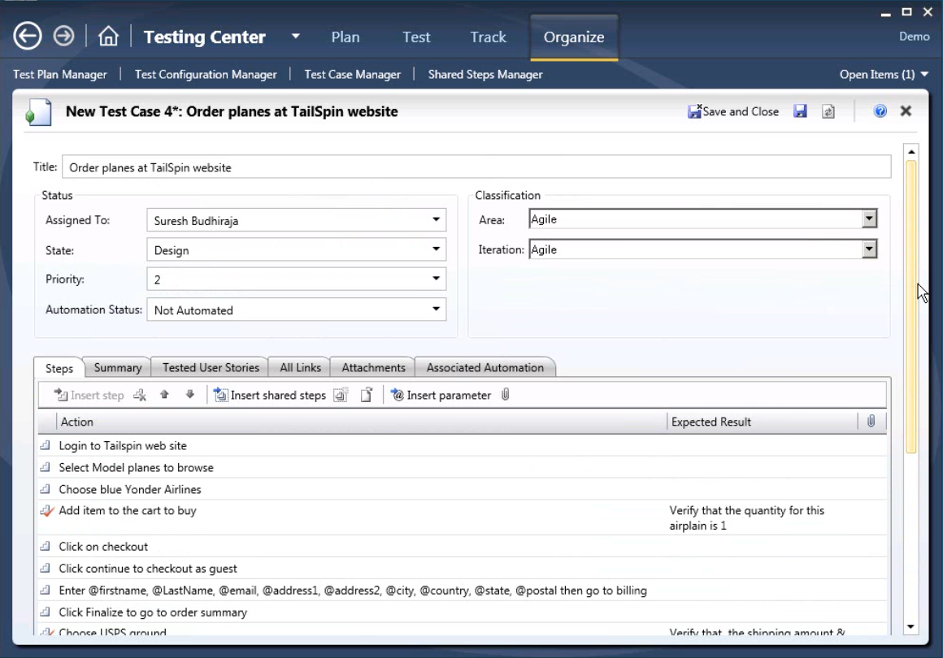
Test Case is first class work item in TFS
Detailed steps along with expected results

Slide 67
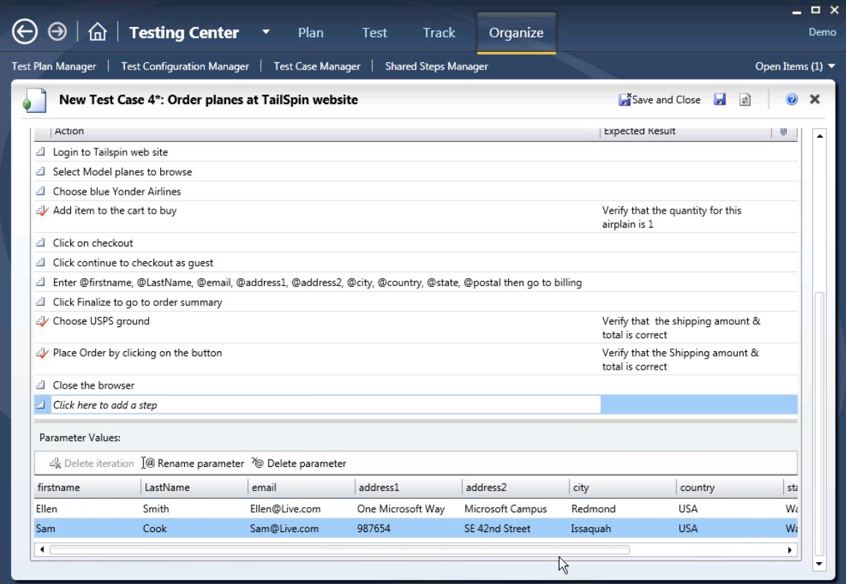
Data drive a test case
Specify data in parameter table

Slide 68
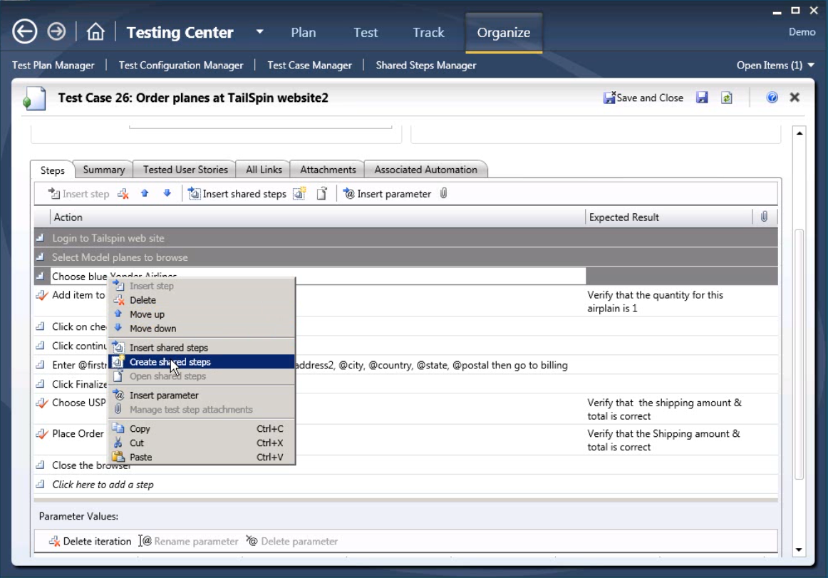
Select common steps and convert to Shared Steps

Slide 69
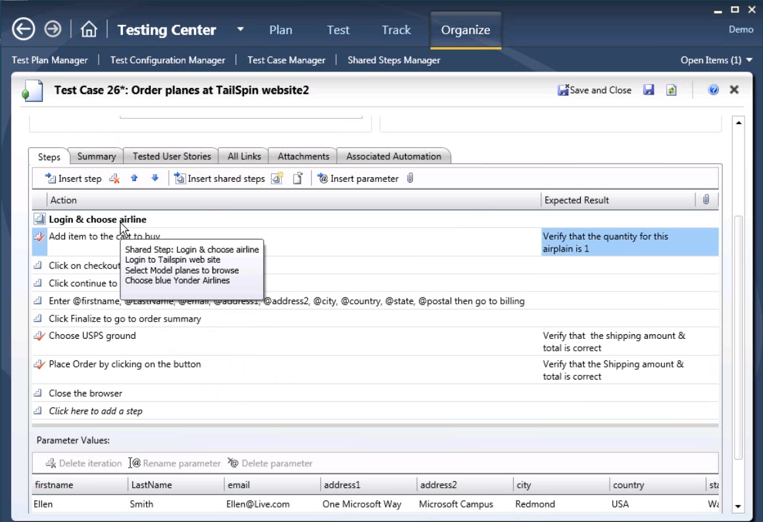
Shared Steps allows for common steps to be reused across test cases

Slide 70
Lab Manager
Simplifies environment setup
Improving deployment quality
Simplifies testing multiple configurations
Enables reverting to baseline configuration
Improves test hardware utilization

Slide 71
Lab Management Architecture
System Center Virtual Machine Manager
Team Foundation Server (TFS)
Lab Management
Hyper-V
Hosts
VM Library
Shares
Test Case Management
Microsoft Test & Lab Manager (MTLM)
VM 1
Share 1
Build Management
VM 2
Share 2
Work Item Tracking
VM 3
Share 3
Source Control
VM 4
Share 4
New
Updated

Slide 72
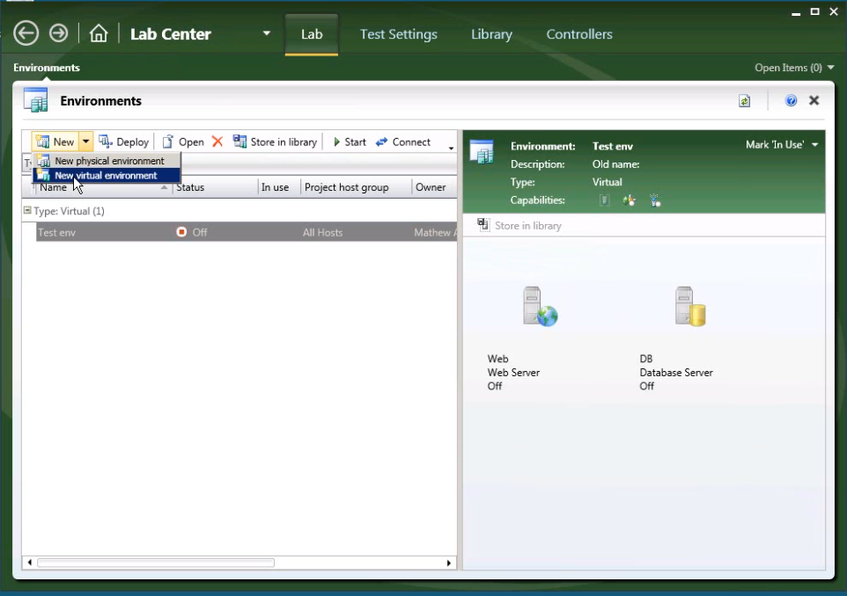
Create Virtual Environment from Lab Center

Slide 73

Specify name and location for environment

Slide 74

Pick role for VM
Select VM from template library

Slide 75

Specify capabilities – “Run Tests” ; “Run Workflows” ; “Network Isolation”

Slide 76

Environment (collection of VMs) created

Slide 77

Manage snapshots for environment
Access environment using Lab Environment Viewer

Slide 78

Lab Management for Distributed Team
Lower cost of ownership
Now have a visual face to the lab!
No waiting - Create machines on a remote site without assistance
Get traction of idle machines using “last accessed time”
Friction free – Mark and reserve
your machines

Slide 79

View your lab

Slide 80

View your lab – Who owns what?

Slide 81
Coded UI Test
Puts recorded actions into code
Dissects action against executing code
Can be associated against test case

Slide 82
demo
Coded UI Test

Slide 83

From Test->new test, click Coded UI test, specify test name and project name

Slide 84

Use existing action recording to generate code

Slide 85

Specify test case which has action recording and click OK

Slide 86

Code generated from action recording – datasource as TestCase

Slide 87

Code generated handles data parameterization

Slide 88

Invoke Coded UI Test Builder for adding assertions

Slide 89

Drag cross-hair onto the control you want to add assertions on

Slide 90

Properties of selected control and its UIMap is shown

Slide 91

Select property to assert on and right click to add assertion

Slide 92

Add the assert

Slide 93

Specify Assert method name and generate code

Slide 94

Code generated for assert method

Slide 95

Add solution to source control

Slide 96

Check-in pending changes

Slide 97

Go to test case that you want to associate the newly created automation

Slide 98

Specify test method and click OK; save test case

Slide 99
Thank You!
Questions?

Slide 100


Slide 101
Contact Info
Eric Strait
Developer Solutions Specialist
estrait@microsoft.com
Steve Lange
Developer Technology Specialist
stevenl@microsoft.com
Based in Phoenix
Based in Denver

Slide 102
Links & Resources
Visual Studio 2010 ALM MSDN Library
TFS Best Practices Guide
Brian Harry’s Blog (Microsoft TFS Adoption)
Team System “Widgets” (comprehensive integrations & utilities list)
Videos: “How Do I?” | VSTSRocks.com
Online Training Options

